Slide 1
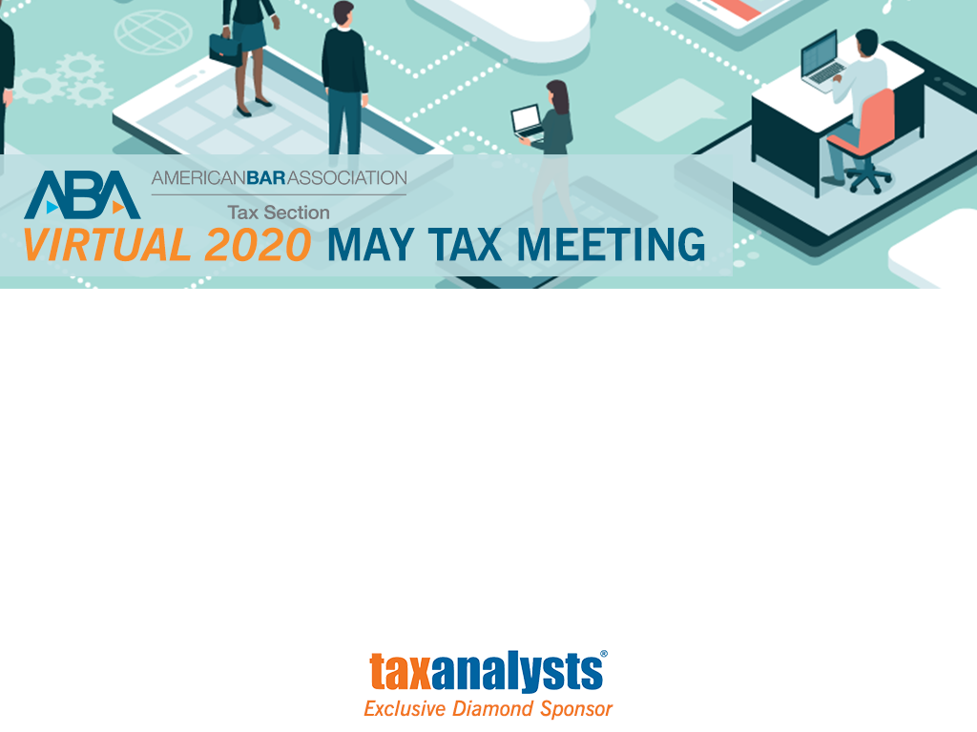
Qualified Severances – New GSTT Solutions in an Old Wineskin
American Bar Association Section of Taxation Virtual 2020 May Meeting

Slide 2
The Panel
Brian P. Tsu
Higgs Fletcher & Mack LLP
San Diego, California
tsub@higgslaw.com
(619) 236-1551
Brian wishes to thank Ethan Shakoori, Esq. of Higgs Fletcher & Mack LLP for his assistance in preparing these slides, though all errors are those of the author alone.

Slide 3
The Problem
Dan died in 1998 and created a testamentary trust for the benefit of his child, Cathy. The trust provides Cathy discretionary income and principal to her for her lifetime. Upon Cathy’s death, the remainder of trust distributes in further trust to Cathy’s descendants, per capita. On Dan’s estate tax return, the executor allocated Dan’s remaining GST exemption of $450,000 to the trust, which had been funded with $1,000,000 of assets.
Today the value of the trust assets is $10,000,000. Cathy is concerned about the tax consequences that would result upon her death.

Slide 4
The Problem - The Issues
GST Tax
Trust has a mixed inclusion ratio of .55 (1-(450,000/1,000,000))
Taxable termination upon Cathy’s death at reduced rate of 22% (.55 x 40% GST tax rate)
What can be done?
- Unavailability of late allocation – deceased transferor
- Unavailability of Treas. Reg. § 26.2654-1(b) severance
- Qualified severance is available

Slide 5
The Problem - The Issues (cont’d)
Other tax considerations:
How much estate tax basic exclusion does Cathy have remaining and what is the fair market value of her assets outside of the trust?
What is the basis of the trust’s various assets?
Will any of the assets be subject to state estate taxation?

Slide 6
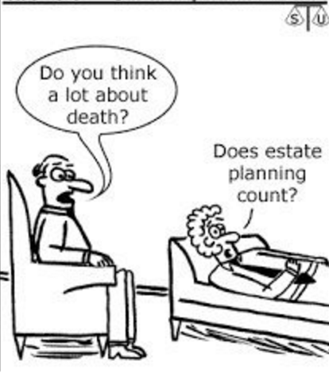
Qualified Severance Generally
A qualified severance allows one trust that is only partially exempt from GST tax (mixed inclusion ratio) to be divided into two trusts,
one of which is totally GST exempt
(inclusion ratio of 0) and one that
is not exempt at all (inclusion ratio
of 1). I.R.C. § 2642(a)(3).

Slide 7
Qualified Severance Requirements
A qualified severance must satisfy the following requirements:
The governing instrument or applicable local law allows the division into the resulting trusts.
The “date of severance” is either the date selected by the trustee of the original trust or the court-imposed date of funding.
The trust is severed on a fractional basis and the sum of the fractions are 100%.
The resulting trusts provide, in the aggregate, for the same succession of interests of beneficiaries.
One resulting trust has an inclusion ratio of 1 and the other an inclusion ratio of 0.
Treas. Reg. § 26.2642-6(d).

Slide 8
Qualified Severance Basics - Eligibility
Qualified Severance under I.R.C. § 2642(a)(3)
Any trust, with an inclusion ratio of 0, 1 or in between, is eligible for a qualified severance under I.R.C. § 2642(a)(3).
A qualified severance may occur at any time prior to the termination of the trust.
Compare with severance under Treas. Reg. § 26.2654-(1)(b)
Limited to the severance of a trust that is included in a decedent/transferor’s gross estate (i.e., a revocable inter vivos trust or a testamentary trust).
Such a severance must be initiated prior to the due date for the decedent/transferor’s estate tax return.

Slide 9

Qualified Severance Basics - Funding
Not only must the trust be severed on a fractional basis, the resulting trusts must be funded using a fraction or percentage of the value of original trust’s assets on the date of severance. The sum of these fractions or percentages must equal 1 or 100%, respectively.
The “date of severance” is the date selected for determining
the value of the trust assets, provided funding is
commenced immediately. Treas. Reg. § 26.2642-6(d)(3).
Upon dividing the trust into exempt and non-exempt trusts,
each trust must be funded within a “reasonable time” from
the date of severance. A “reasonable time” for this
Purpose may differ, depending on the types of assets,
but may not exceed 90 days. Treas. Reg. § 2642-6(d)(3).

Slide 10
Qualified Severance Basics – Funding (cont’d)
Funding of such shares may occur on a pro rata or non-pro rata basis. Pro-rata funding involves the funding of a pro rata portion of each trust asset into both the exempt and non-exempt trust.
For non-pro rata funding:
each asset received by a resulting trust must be valued, solely for funding purposes, by multiplying the fair market value of the asset held in the original trust as of the date of severance by the fraction or percentage of that asset received by that resulting trust; and
the assets must be valued without taking into account any discount or premium arising from the severance, for example, any valuation discounts that might arise because the resulting trust receives less than the entire interest held by the original trust.
Treas. Reg. § 26.2642-6(d)(4) (emphasis added).

Slide 11
Qualified Severance Basics - Succession of Interests
This requirement is met if the beneficiaries of the resulting trusts and the interests of such beneficiaries in those trusts, when viewed collectively, are the same as the beneficiaries and interests with respect to the trust prior to severance.
No severance upon generational lines. Treas. Reg. § 26.2642-6(d)(5); (j), Example 3.

Slide 12
Qualified Severance Basics - Succession of Interests (cont’d)
As for discretionary “pot” or “spray” trusts, this requirement is met if:
The terms of the resulting trusts are the same, even if a permissible distributee is not a beneficiary of each resulting trust;
each beneficiary’s interest in the resulting trusts equals their interest in the original trust, as determined by the instrument or, if none, on a “per capita” basis; and
severance does not
shift a beneficial interest to a lower generation; or
extend the time for vesting of an interest beyond that which is provided for in the original trust. Treas. Reg. § 26.2642-6(d)(5)

Slide 13

Practical Considerations

Slide 14
Practical Considerations
Trust Instrument
Funding of the ResultingTrusts
Transfers between Exempt and Non-Exempt Trusts
Special Assets
Reporting

Slide 15

Trust Instrument

Slide 16
The Trust Instrument - What Does it Say?
In assessing the availability of a qualified severance review the trust instrument first.
By what means will the trust be divided into an exempt and non-exempt trust?
Is there a mechanism to include the resulting non-exempt trust in the gross estate of the non-skip beneficiary?

Slide 17

The Trust Instrument - Division
By what means will the trust be divided into an exempt and non-exempt trust?
Ideally the trust instrument will provide the trustee
the power to divide the trust.
If this power is missing or insufficient, look to state law.
If state law is insufficient consider a change in trust situs.
What will be the terms of each such trust?
The resulting trusts must provide for the same
succession of interest.

Slide 18
The Trust Instrument - Inclusion of Non-Exempt Trust
Is there a mechanism to include the resulting non-exempt trust in the gross estate of the non-skip beneficiary?
- Inclusion of the trust causes a change in transferor so no generation-skipping transfer results (here a taxable termination). Treas. Reg. § 26.2612-1(b)(1), (f) (example 5).
- Ideally the trust instrument will provide a flexible means for including all or a portion of the trust in the gross estate of the non-skip beneficiary. This may include:
a contingent testamentary general power of appointment;
the power of an independent trustee to grant or remove such a power; or
some combination of the above.
- If the trust instrument does not contain any of the above, consider:
triggering the “Delaware tax trap”;
trust decanting; or
trust modification.

Slide 19
The Trust Instrument - Inclusion of Non-Exempt Trust (cont’d)
Considerations as whether to include the non-exempt trust:
Trustee’s fiduciary duties.
Who are the presumptive remaindermen and are they all skip persons? If not, no taxable termination.
What is the current value of the non-exempt trust? What is the value outlook for the trust?
What is the non-skip beneficiary’s remaining estate tax basic exclusion and the fair market value of their assets outside of the trust?
What is the basis of the non-exempt trust’s assets (see I.R.C. § 1014(b)(9))
Where are the non-exempt trust’s assets located and are state estate taxes relevant?

Slide 20

Funding of the Resulting Trusts

Slide 21
Funding - Pro Rata v. Non-Pro Rata
Pro rata funding considerations:
Arguably less complex
Fractionalized ownership of
- SMLLCs
- 100% interests in real property
Non-pro rata funding considerations:
Appraisals required
May take into consideration specifics of particular trust assets (e.g. valuation outlook, basis)
May be used to avoid:
- fractional ownership
- state estate taxation depending on location of assets
Open question regarding valuation of encumbered property
What about over or underfunding where there is insufficient cash or liquid assets?

Slide 22
Pro Rata Funding - Fractionalized Ownership of SMLLCs
If the original trust was the sole member of an LLC and the qualified severance is funded on a pro rata basis, this results in a two (or more) member LLC ownership structure.
If the trusts are non-grantor trusts, the resulting entity is a partnership for federal income tax purposes pursuant to Treas. Reg. § 301.7701-3(b)(1)(i).
With single-member LLCs, distributions and other transactions between the entity and sole member are disregarded for tax purposes. The resulting trusts, as members, must now consider the tax consequences associated with distributions of cash or property from the entity. See I.R.C. § § 704(c), 707, 737.

Slide 23
Pro Rata Funding - Fractionalized Ownership of Real Property
If the original trust owned 100% of a parcel of real property and the qualified severance is funded on a pro rata basis a tenancy in common results.
If the property generates rental income consider:
all of the non-tax aspects of TIC ownership; and
possibility that co-tenancy is treated as a partnership for income tax purposes. See factors set forth in Rev. Proc. 2002-22.

Slide 24
Non-Pro Rata Funding - Encumbered Property
Non-pro rata funding requires that the resulting trusts be funded using a fraction or percentage of the fair market value of original trust assets.
How do we account for encumbered property? Gross or net of encumbrance?
Does the answer depend on the nature of the encumbrance?
Note that mortgages, indebtedness and claims are deductible in calculating GST tax imposed on taxable termination under I.R.C. § 2622(b).

Slide 25

Transfers Between Exempt and Non-Exempt Trusts
[PICTURE]

Slide 26
Transfers Between Exempt and Non-Exempt Trusts
After the exempt and non-exempt trusts have been funded, there may be instances (for tax and non-tax reasons) where it is desirable for one or more assets of a particular resulting trust to be exchanged with that of the other.
Assuming that such a transfer does not raise a fiduciary issue, the means for such a transfer are limited, and may constitute a sale or exchange for income tax purposes.

Slide 27
Transfers Between Exempt and Non-Exempt Trusts (cont’d)
The recognition of gain may be avoided if:
The exempt trust and non-exempt trust are both grantor trusts as to which a grantor is treated as the owner of both trusts (see Rev. Rul. 85-13);
The assets in question are real property and the exchange is structured as a I.R.C. § 1031 exchange; or
The assets are contributed by the resulting trusts to a partnership and are subsequently distributed, though consider the “mixing bowl” rules and their limitations.

Slide 28

Special Assets

Slide 29

Special Assets - Business Entities
Review the stock/partnership/LLC agreement of any interest held by the trust as it may impose restrictions that may inhibit the transfer of such interest.
Ensure that the funding of such interest
is not a “transfer” that triggers a buy-sell
right.
Where the original trust holds S corporation shares consider whether the severance causes a change from ESBT to a QSST (e.g. qualified severance of a pot trust)?

Slide 30
Special Assets - Interests in Investment Funds
Investment funds are typically transferable and valued as of specific dates (e.g. 1st day of the month). Accordingly, the trustee should consider the valuation dates of any investment funds that the original trust may hold in establishing the date of severance so that such interests may be valued for purposes of the qualified severance.

Slide 31
Special Assets - 1031(f) Property
As discussed above, one way of moving real property between exempt and non-exempt trusts on a tax-free basis is via a I.R.C. § 1031 exchange. However, consider subsection (f).
Under I.R.C. § 1031(f), a taxpayer exchanging like-kind property with a “related person” may recognize gain if, within 2 years of the date of the last transfer, the (1) related person disposes of the relinquished property or (2) the taxpayer disposes of the replacement property. The taxpayer recognizes any gain in the taxable year in which the disposition occurs. The term “related person” includes relationships described in § 267(b).
Under I.R.C. § 267(b) a related person includes a fiduciary of a trust and a fiduciary of another trust, if the same person is the grantor of both trusts.

Slide 32

Reporting

Slide 33
Reporting - Form 706-GS(T)
The requirements for reporting a qualified severance are set forth in Treas. Reg. § 26.2642-6(e).
The words “Qualified Severance” must appear atop IRS Form 706-GS(T).
Due date. Notice to the IRS should be mailed by the due date of the gift tax return (including extensions) for gifts made during the year in which the severance occurred.
Information concerning the original trust and the resulting trusts is required.

Slide 34
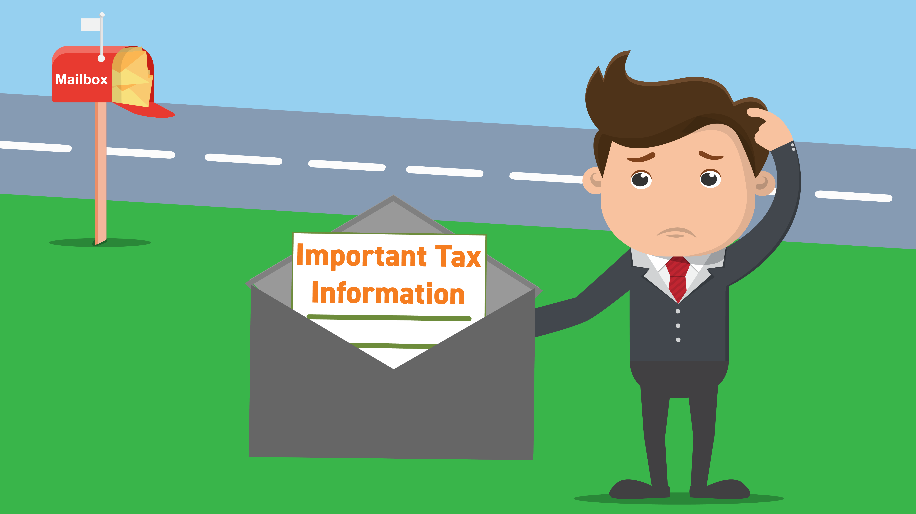
Reporting - Requirements
Information regarding the original trust:
The name of the transferor;
The trust’s name and date of creation;
The trust’s tax identification number; and
The pre-severance inclusion ratio.
Information regarding each of the resulting trusts:
The trust’s name and tax identification number;
The date of severance;
The fraction of the total assets of the original trust received by each resulting trust;
Other details explaining the basis for funding each resulting trust; and
The inclusion ratio.

Slide 35
Reporting - What Else?
Consider including with the Form 706-GS(T):
Calculation of the trust’s inclusion ratio prior to qualified severance
Items that substantiate “other details” under Treas. Reg. § 26.2642-6(e)(3)(iv), such as:
A funding plan
Assets of exempt and non-exempt trusts
Value of each asset as of date of severance
Funding date of each asset
Appraisals (although appraisals are not expressly required, provide if resulting trusts are funded on a non-pro rata basis)

Slide 36
Biography
Brian P. Tsu is a partner at Higgs Fletcher & Mack LLP in San Diego. He is a Fellow of the American College of Trust and Estate Counsel (“ACTEC”) and is a Certified Specialist in both (1) Estate Planning, Trust & Probate Law and (2) Taxation Law, each by the State Bar of California, Board of Legal Specialization. He has also been selected by his peers for inclusion in The Best Lawyers in America® in the area of Trusts and Estates since 2016.
Brian represents high-net-worth individuals in the areas of domestic and international estate planning, related areas of taxation and closely-held family business planning. He also advises fiduciaries in complex trust and estate administrations, particularly when tax or cross-border issues are present.
tsub@higgslaw.com
(619) 236-1551

Slide 37
Questions?
All attendees can submit questions via the Q&A feature on the webinar interface

